Slide 1
Learning SDN with NSX and Open vSwitch as a vSphere admin for fun and profit
By @arielsanchezmor
V1.2

Slide 2
You can find this PPT and any source code in blogs.arielsanchezmora.com
Or tweet @arielsanchezmor

Slide 3
A favor
Take a pic during this session. Tweet it out with #CinciVMUG
I really like interacting with people in Twitter and the #vCommunity – send me any thoughts from today, your cat pictures and your blog posts!

Slide 4
Interactive session
I’m no networking expert! If you see something wrong or I missed critical info, please let me and the room know, this community is here so we help each other!
Today is more about concepts than actual technical doing, so don’t leave any question unasked!

Slide 5
Agenda
About me
A little history of networking
SDN concepts
How to learn SDN, coming from vSphere
Why I think it’s important to learn SDN
Further reading
Q&A

Slide 6
A bit about me
Costa Rican in Pittsburgh, moving to FL
Sr TAM @VMware, CTO Ambassador
Advocate of the vCommunity (vBrownBag, vExpert, VMUG, VTUG, vBeers, vBrisket…)
I started using Twitter in 2013 for VMW
I want to help other people present at VMUG!
vExpert PRO – I’ll help you prepare for vExpert

Slide 7
My background in networking
CCNA and CCNP courses in 2006-2008
NOC engineer, IT operations
In love with OpenBSD and Open vSwitch
I still think CCNA is one of the best network trainings to start. Anyone do the Network+ ?
Networking training isn’t easy
Linux certifications are probably the best to do?

Slide 8
BIG disclaimer slide
Notice, no VMware logos anywhere
This is purely a community session I geeked up
I am a VMware fanboy though
I believe NSX is the best SDN solution today
It’s important for vSphere admins to learn and adapt to also being network experts to remain relevant & profitable in the multi-cloud future

Slide 9
A little bit of history
In 1969, ARPA awarded the contract to build the most integral piece of this network - a computerized switch - to Bolt Beranek and Newman (BBN), a small Cambridge, Massachusetts, company.

Slide 10
A little bit of history
6 engineers at BBN knew it was possible to do what larger companies - including AT&T and IBM - had dismissed as impossible. Making computer networking possible required inventing new technologies.
Where Wizards Stay up Late: The Origins of the Internet amazon link

Slide 11
Rise of networking as a separate silo
In the beginning, the sysadmin did all the networking
To this day BSD-based routers and firewalls power most of the internet, because of stability and permissive licensing
A brief history of Cisco’s rise
Network industry’s recipe was buy bigger switch/router/firewall to handle demand

Slide 12
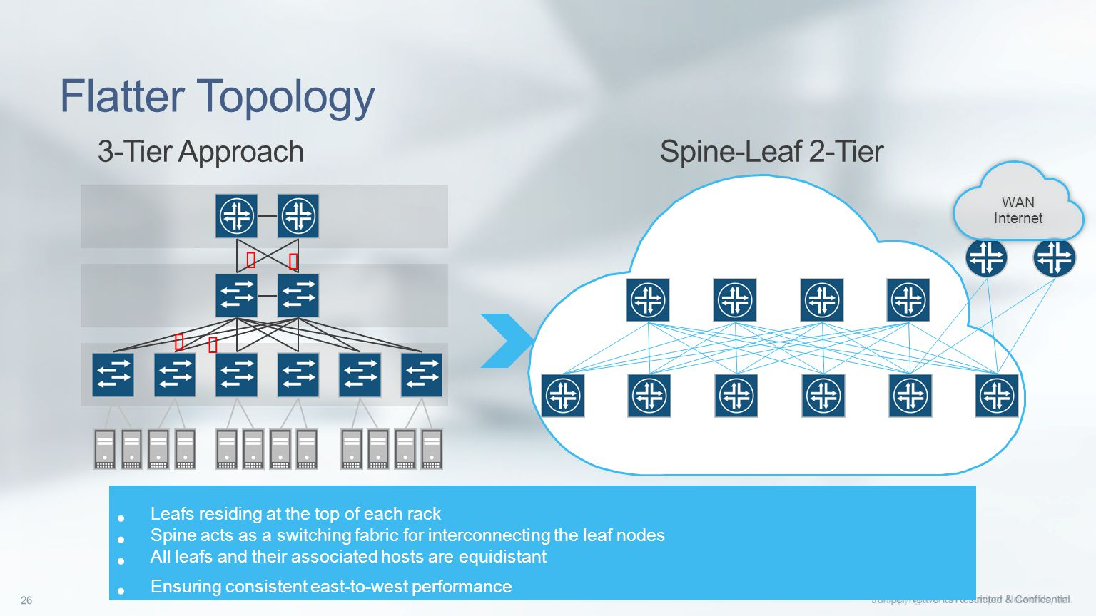
A different way came along
Benefits of scale out (leaf-spine) vs scale up

Slide 13
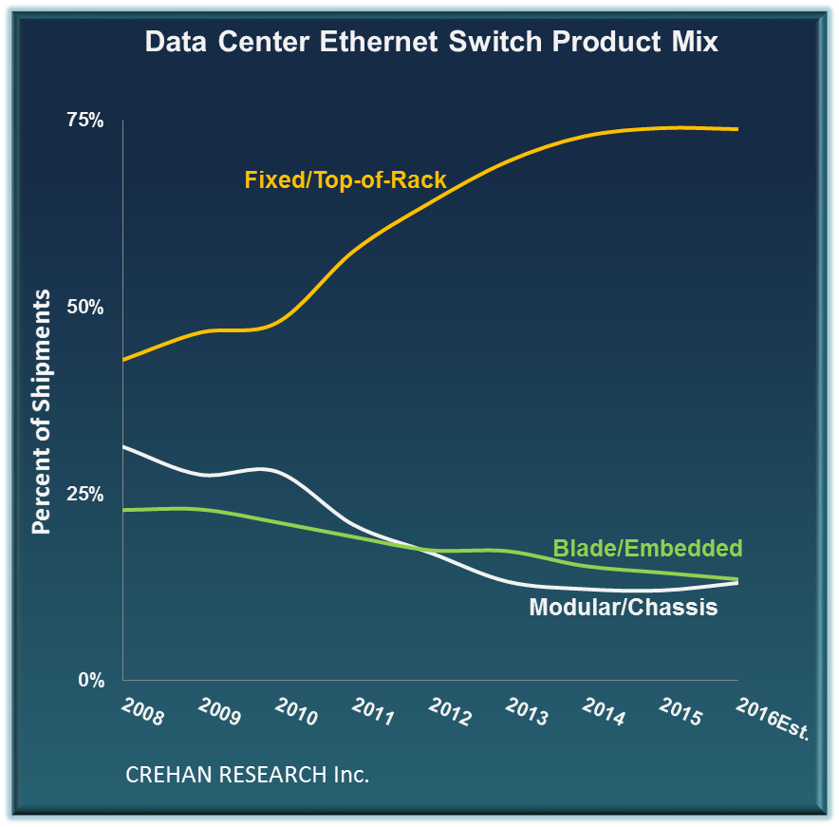
The trend has reached mainstream

Slide 14
Networking changes
A big breakthrough was the invention of overlay networks
Management of individual devices, upgrade and migrations of big devices is very painful
Servers/NICs became cheaper, buy direct
Cloud scale companies solved the problems themselves, with the help of academia

Slide 15
Tenets of Software Defined Networking
Remove dependence on hardware-specific vendor management interfaces
Operate programmable management/control plane separate from data plane
Dictate network behavior from a central point, running as a distributed system
Programmatical changes for new network manipulation needs

Slide 16
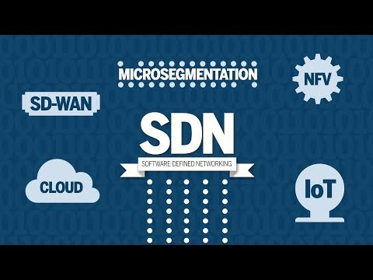
A recent video

Slide 17
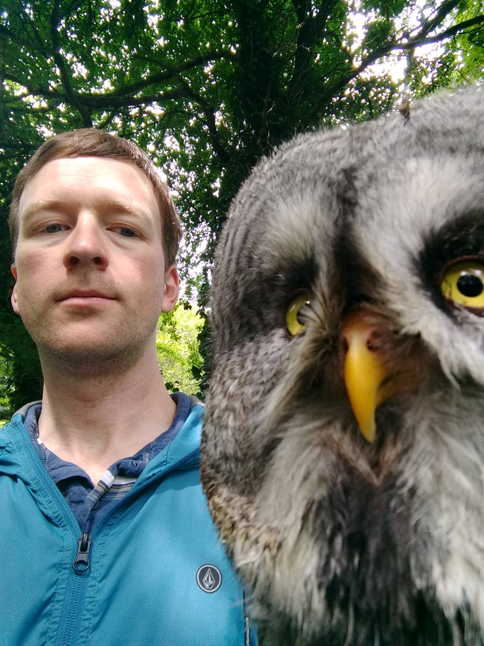
History and concepts of SDN
Nicira -> Open vSwitch -> NSX
Nicira was co-founded by Martin Casado, who served as the CTO, Nick McKeown and Scott Shenker
Ben Pfaff, an early employee, has been great at promoting Open vSwitch and SDN

Slide 18

My interview with Ben Pfaff
Ben Pfaff has been with VMware since 2012, coming from Nicira, a startup out of Stanford
He founded the Open vSwitch project
What is Open vSwitch, in his own words?
(Network programmability with flexibility)

Slide 19
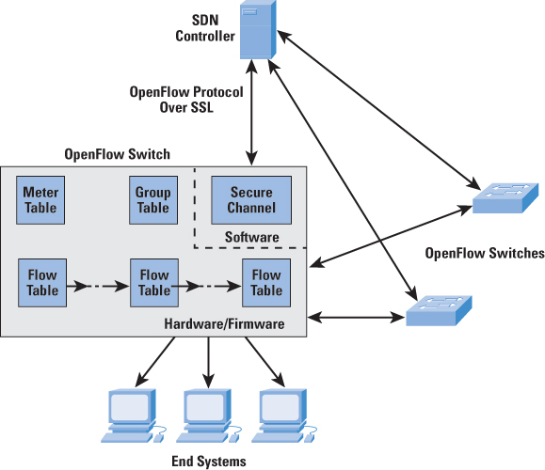
Openflow / Open vSwitch
Choice in OpenFlow controllers
Production quality open source software switch

Slide 20
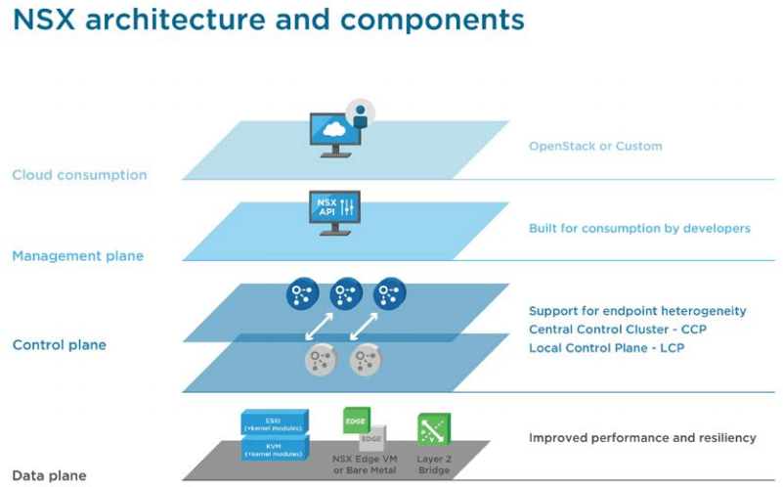
NSX Data Center for vSphere

Slide 21
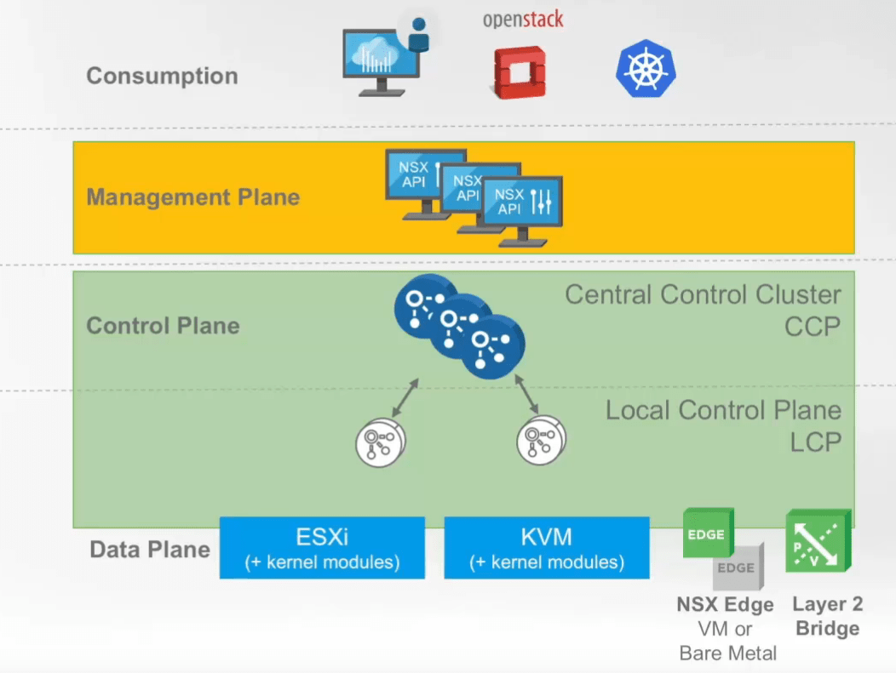
NSX-T for Data Center
Works with several Compute Managers
New N-VDS or OvS

Slide 22
NSX Differences for V and T
NSX-V = NSX Data Center for vSphere
NSX-T = NSX-T Data Center
NSX –V | NSX-T
Requires vSphere | Independent
Requires DVS | Installs N-VDS or OVN Kernel Modules
Only supports ESXi | Supports basically any Enterprise OS
Today has more features / integrations | Less amount but newer types
Can handle vSphere cases | Can handle all hybrid cloud cases

Slide 23
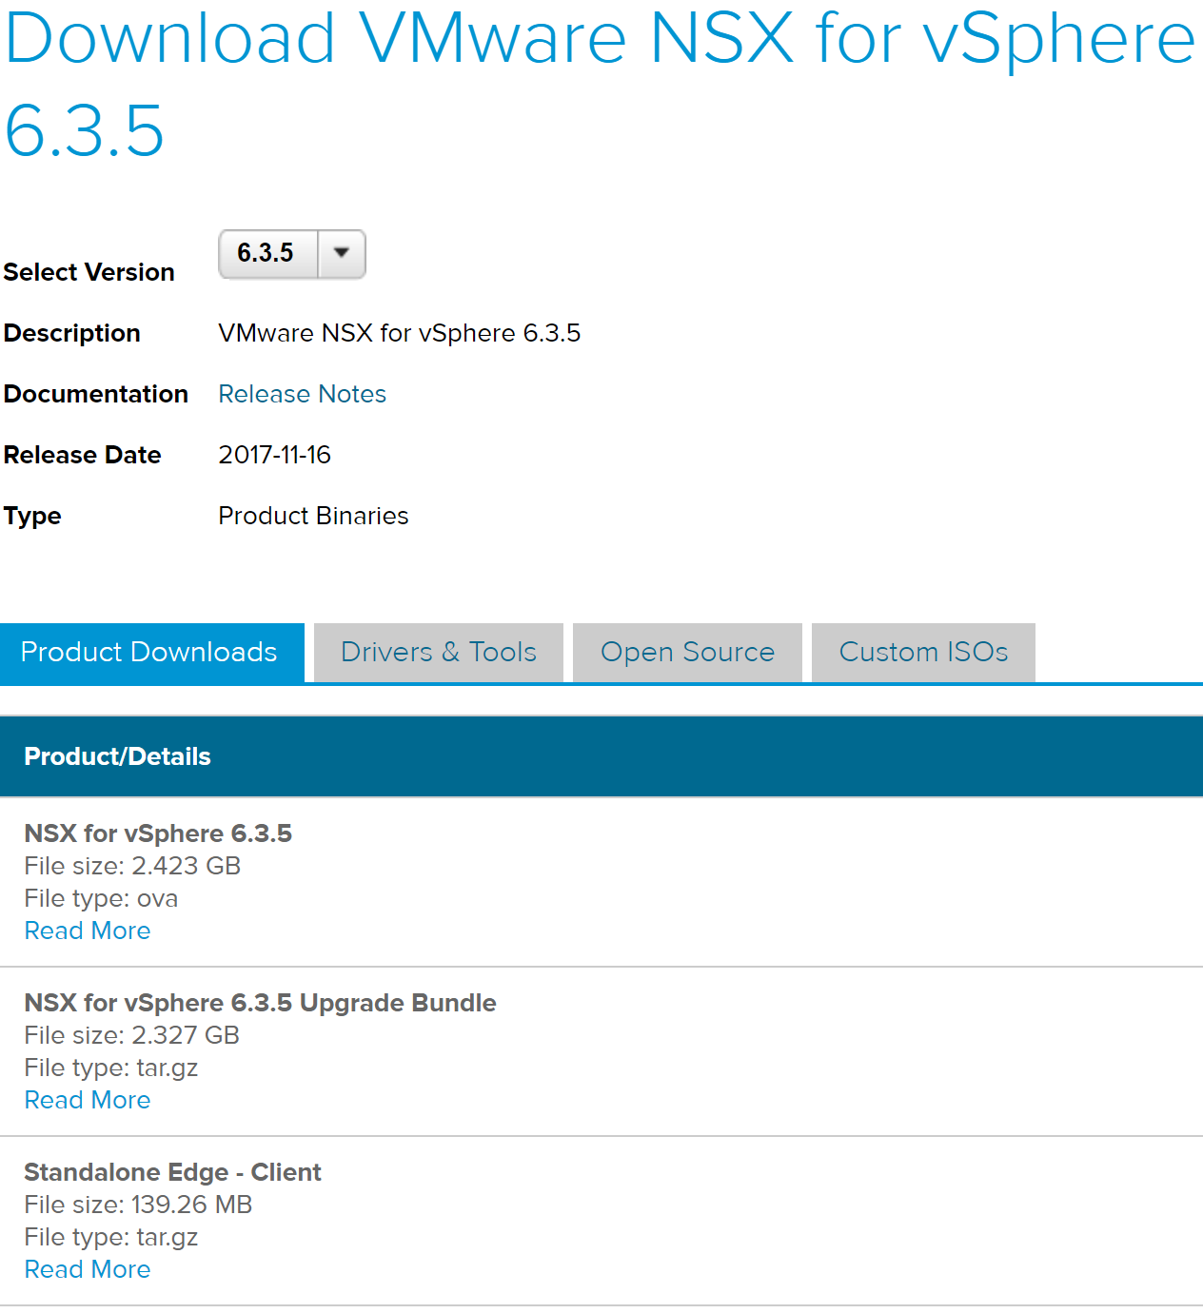
NSX Data Center for vSphere DLs

Slide 24
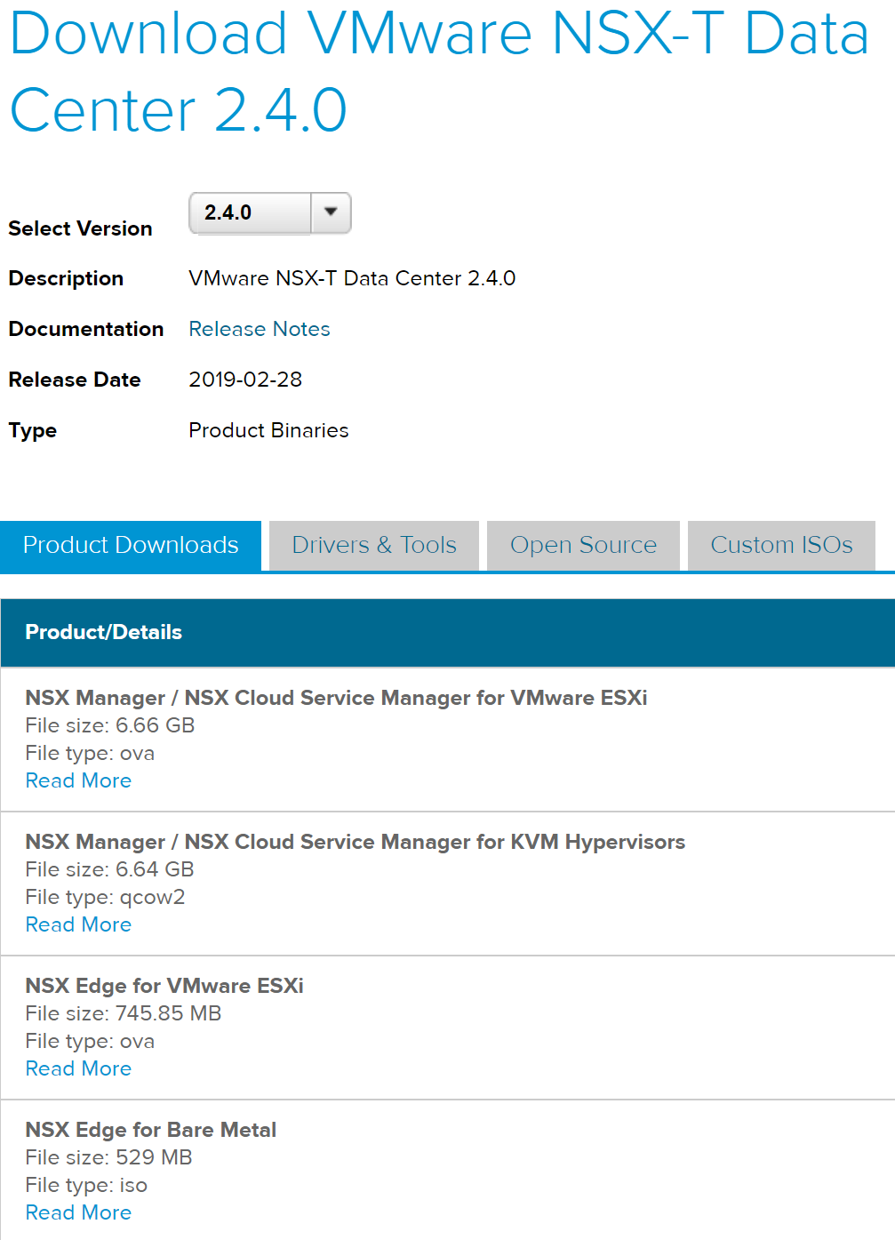
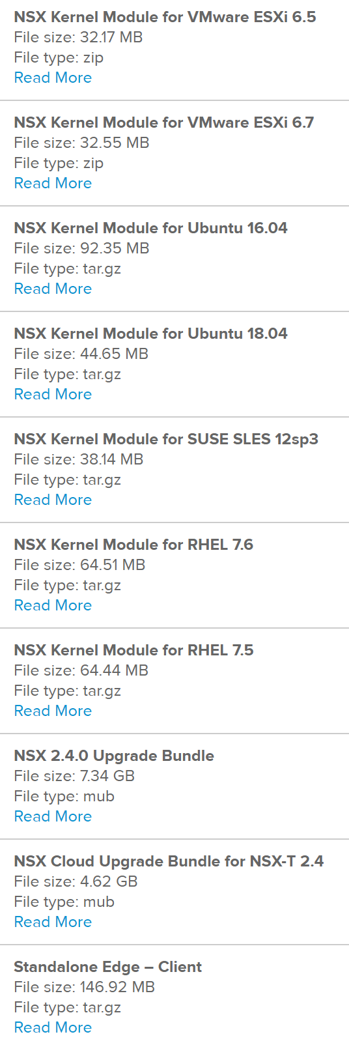
NSX-T Data Center downloads

Slide 25
Concepts in common for SDN
Network services: routing, switching, load balancing, firewalling (all layers)
There’s a hypervisor (vSphere, Linux KVM host)
There’s a vSwitch (vSphere standard or distributed, N-VDS for NSX-T, open vSwitch)
There’s a differentiation from data, control and management planes
Requirement is to scale and upgrade software on demand

Slide 26
Learning SDN with NSX/OvS
We need a networking background (TCP/IP, routing, firewall concepts)
Hey if you’re CCIE this is easy!
Classes:
NSX-V Install Configure Manage, Troubleshooting and Operations (NSX-T now has ICM as well!)
SDN Associate Certification https://www.opennetworking.org/skills-certification/

Slide 27
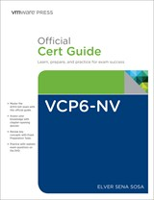
How to learn NSX-V from scratch
VCP6-NV
Elver Sena Sosa’s book is AMAZING
VCAP6-NV free training
There’s no substitute for hands-on
Hands on Labs (nine labs now)
VMUG Advantage (typically discounted today)
Great NSX demo site to show co-workers

Slide 28
Learning Open vSwitch
Go to openvswitch.org
Watch Youtube videos (my SDN playlist)
Start with Linux VMs
Find a cheap Open vSwitch enabled switch (Northbound sold several cheap ones)
Find OpenFlow compliant whitebox switches (Arista, Dell, etc)

Slide 29
I think it’s important to learn SDN
We’re told that IT has to be faster, on-premises now competes with cloud providers
Achieve cloud speed (resources at the standby for consumption and cost optimization)
Networking is no longer the sole domain of the networking team – because of cloud
There are several solutions out there, but concepts tend to be the same

Slide 30
It’s profitable to learn NSX/SDN
Learning the 3 main Cloud VPCs/terminology is one of the best things you can do today for your career!
NSX/SDN is a relatively new field and most of the companies deploying it are large enterprises
Lots of customer, partner, consulting and VMware (PSO, Architect, TAS) openings

Slide 31
SDN is bleeding into K8s
Service Mesh is the networking innovation of 2019
Kubernetes and its networking are the current innovation frontier
Project Antrea was debuted at KubeCon
https://github.com/vmware-tanzu/antrea

Slide 32
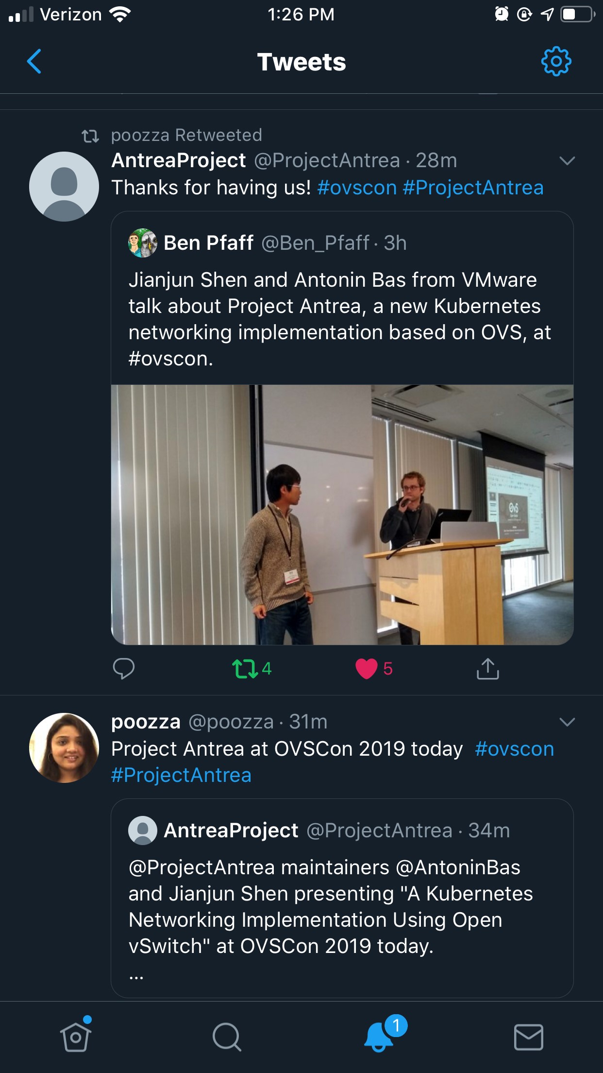
Antrea tweets

Slide 33
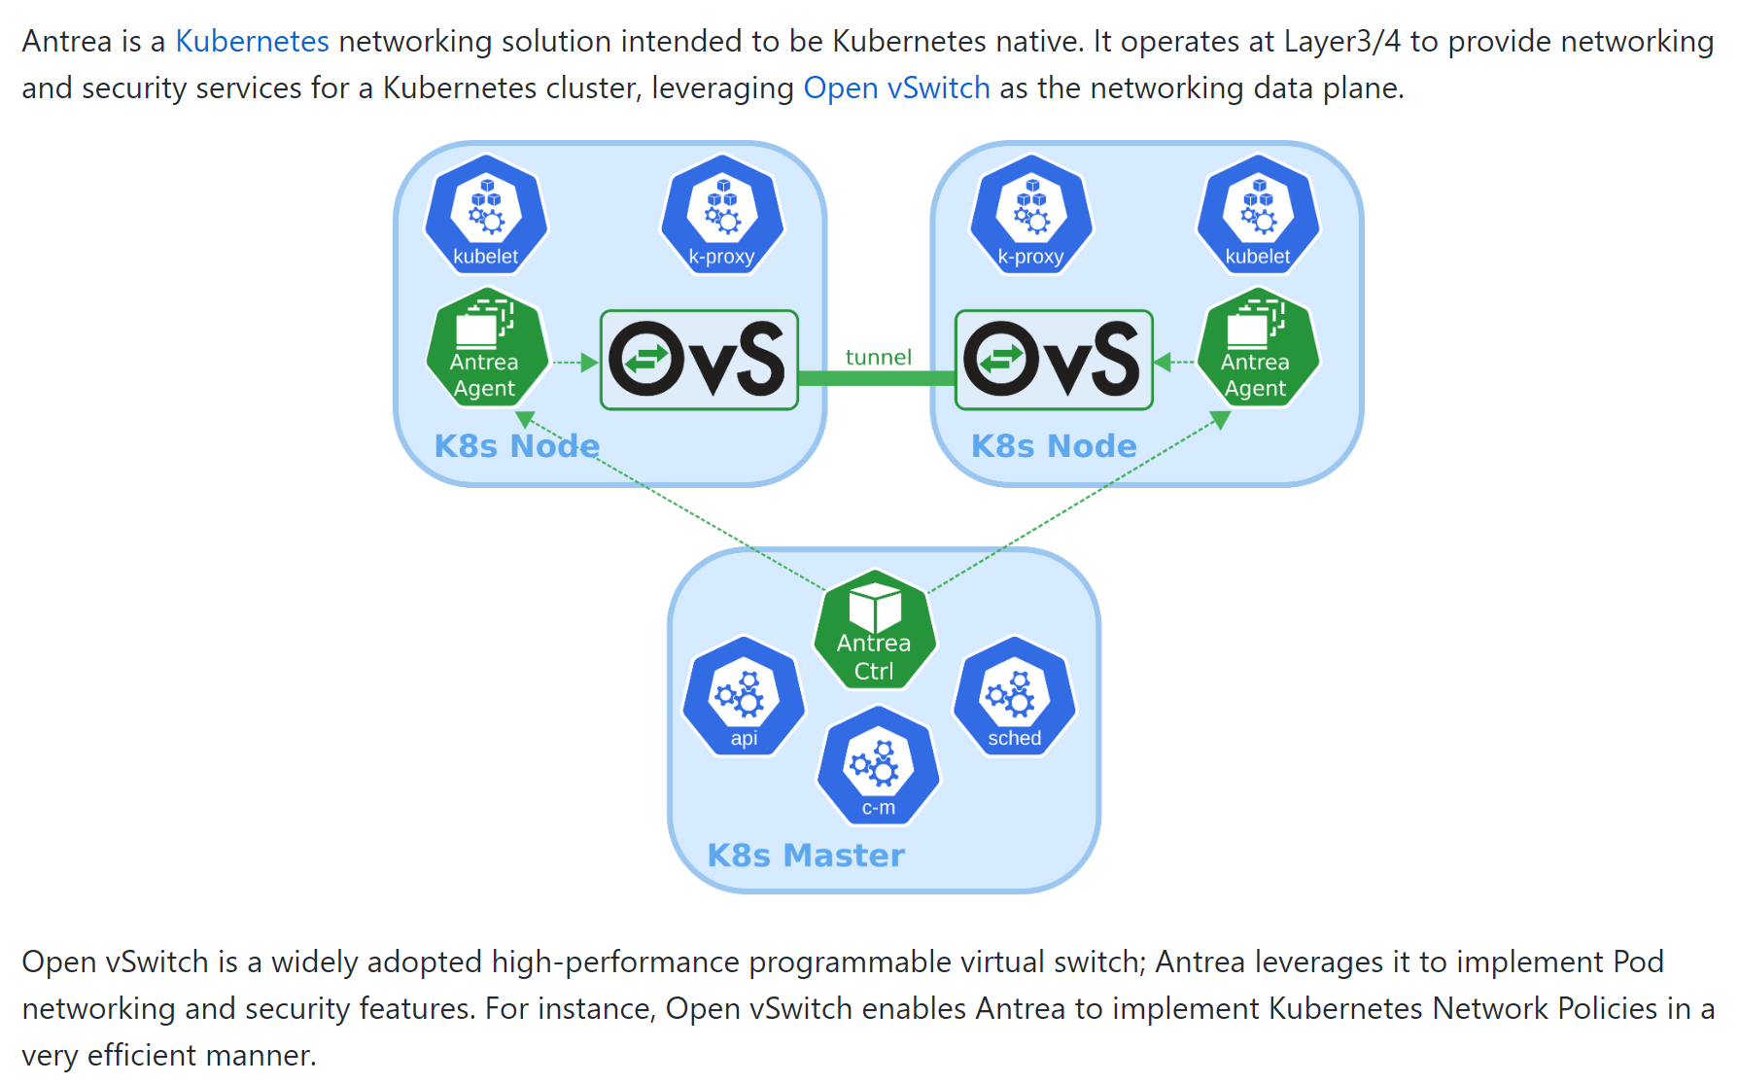
Antrea 1 slide overview

Slide 34
SDN programmability
Your 2019 skill to have: interact with REST APIs
The real power comes from the automation (think Ansible or Terraform) capabilities to provision new networks and services
The networking folks are just waking up to the revolution you’ve heard for years (Git, infrastructure as code)
Software Gone Wild and Packet Pushers

Slide 35
For fun and profit
Be the leader in your company in adopting new network paradigms
Remain relevant in a marketplace where Google/Azure/AWS/VMware are hiring next-gen admins who grasp these concepts
It’s super cool to learn new things!
Has anyone heard of Istio?

Slide 36
Supporting slides

Slide 37
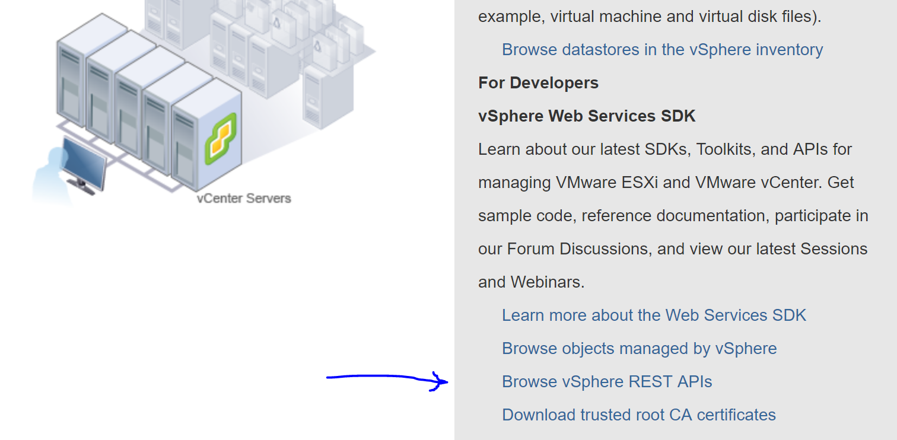
Getting started with REST APIs
https://vCenter/apiexplorer
Kyle Ruddy did an excellent vBrownBag video

Slide 38
Homelab strategy
Linux machines
vSphere hosts, with vCenter
Switches that can handle increased MTU
Enough RAM to run both V and T ☺
More advanced:
Install Faucet as an OpenFlow Controller as a container in a Pi, following this Demo by Ben Pfaff
Connect both OvS physical switches and the Linux host to the controller, and compare to NSX-T

Slide 39
Further Reading
With NSX you really want to dig into the documentation
NSX Data Center for vSphere documentation and 6.4.4 installation guide
NSX-T Data Center documentation and 2.3 installation guide
VMTN forums are very active!

Slide 40
My favorite links on SDN
SDN by Wikipedia
OpenFlow by Wikipedia
Leaf spine by Mellanox and Pica8
Amit Vahdat of Google Networking explaining their pain points that led to SDN adoption
Today, just Google and watch some videos, note the date as some are from early 2000s

Slide 41
Keep up to date with OvS
OvS Orbit podcast (65+ episodes!)
OvS Con Youtube Channel (2015-2018!)
Follow Ben_Pfaff https://twitter.com/Ben_Pfaff
OVS CON https://www.openvswitch.org/support/ovscon2019/
Mailing list https://mail.openvswitch.org/mailman/listinfo

Slide 42
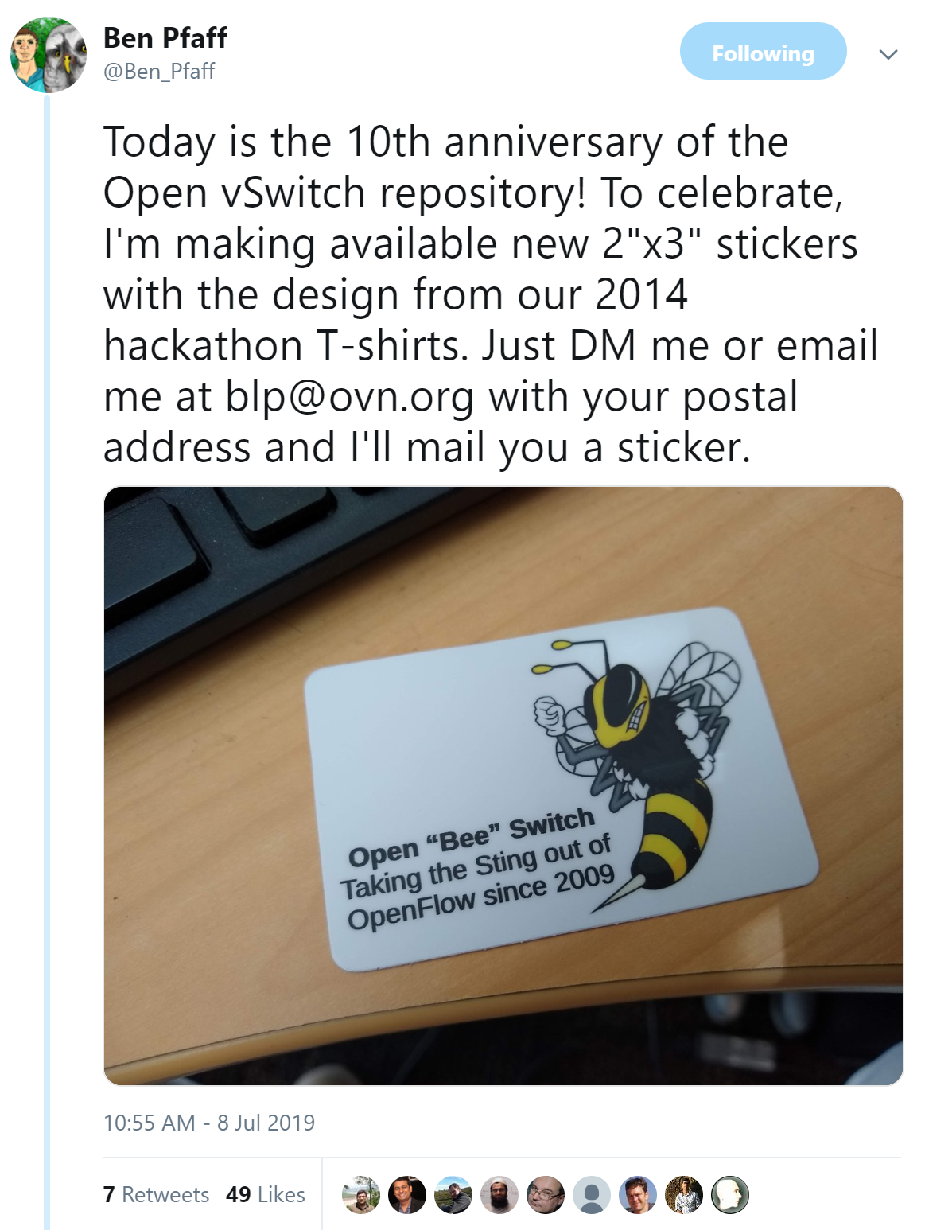

Slide 43
Keep up to date with general SDN
Justine Sherry is a Carnegie Mellon University professor and very active on twitter
https://twitter.com/justinesherry
http://www.justinesherry.com/
Programmable Networks Course schedule with reading assignments

Slide 44
We’re done ☺
Please please give feedback to me
I have some ideas on what else I can do, but I want to know what you got out of it
@arielsanchezmor on Twitter or in the VMware Code Slack

